Slide 1
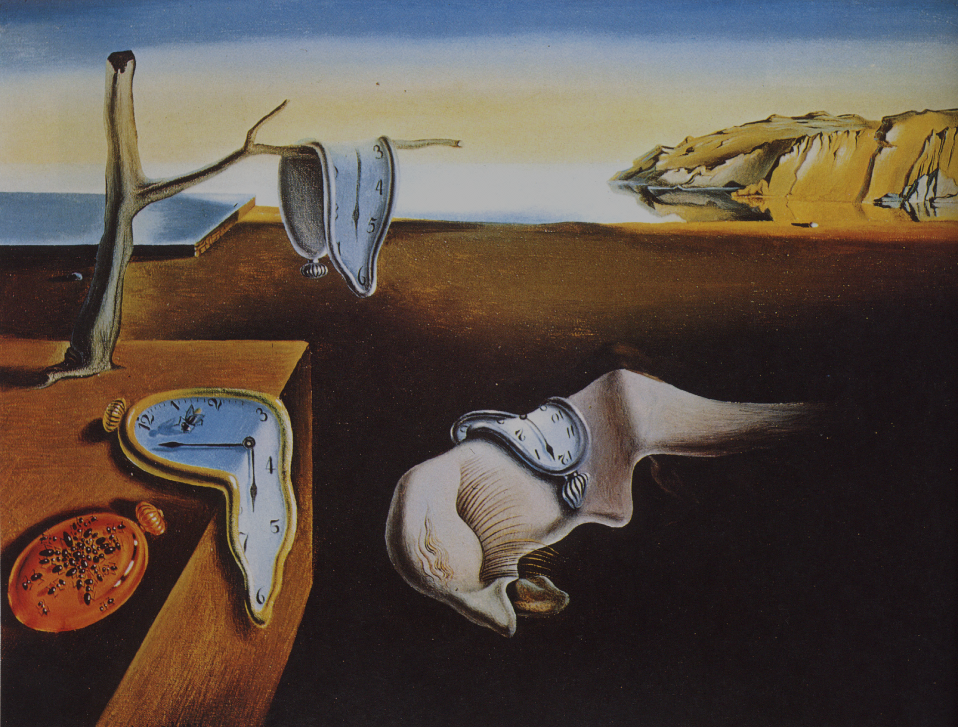
Remote Memory Persistency
Aasheesh Kolli
Jayneel Gandhi
Irina Calciu
Stanko Novakovic
Dali, Salvador. The Persistence of Memory. 1931.
Museum of Modern Art. New York City.

Slide 2
Why persistence?
Data must always be recoverable, even in the
presence of unexpected failures (not uncommon)
2

Slide 3
Conventional recovery solutions
Slow,
Non-volatile, block storage device
3

Slide 4
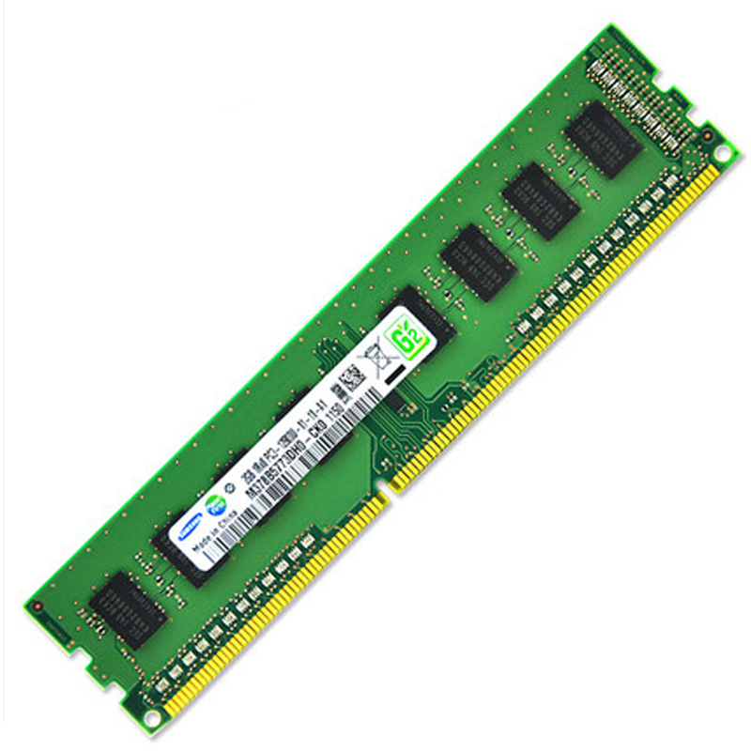
Persistent Memory (PM)
Non-volatility
Performance
Can revolutionize recovery data management

Slide 5
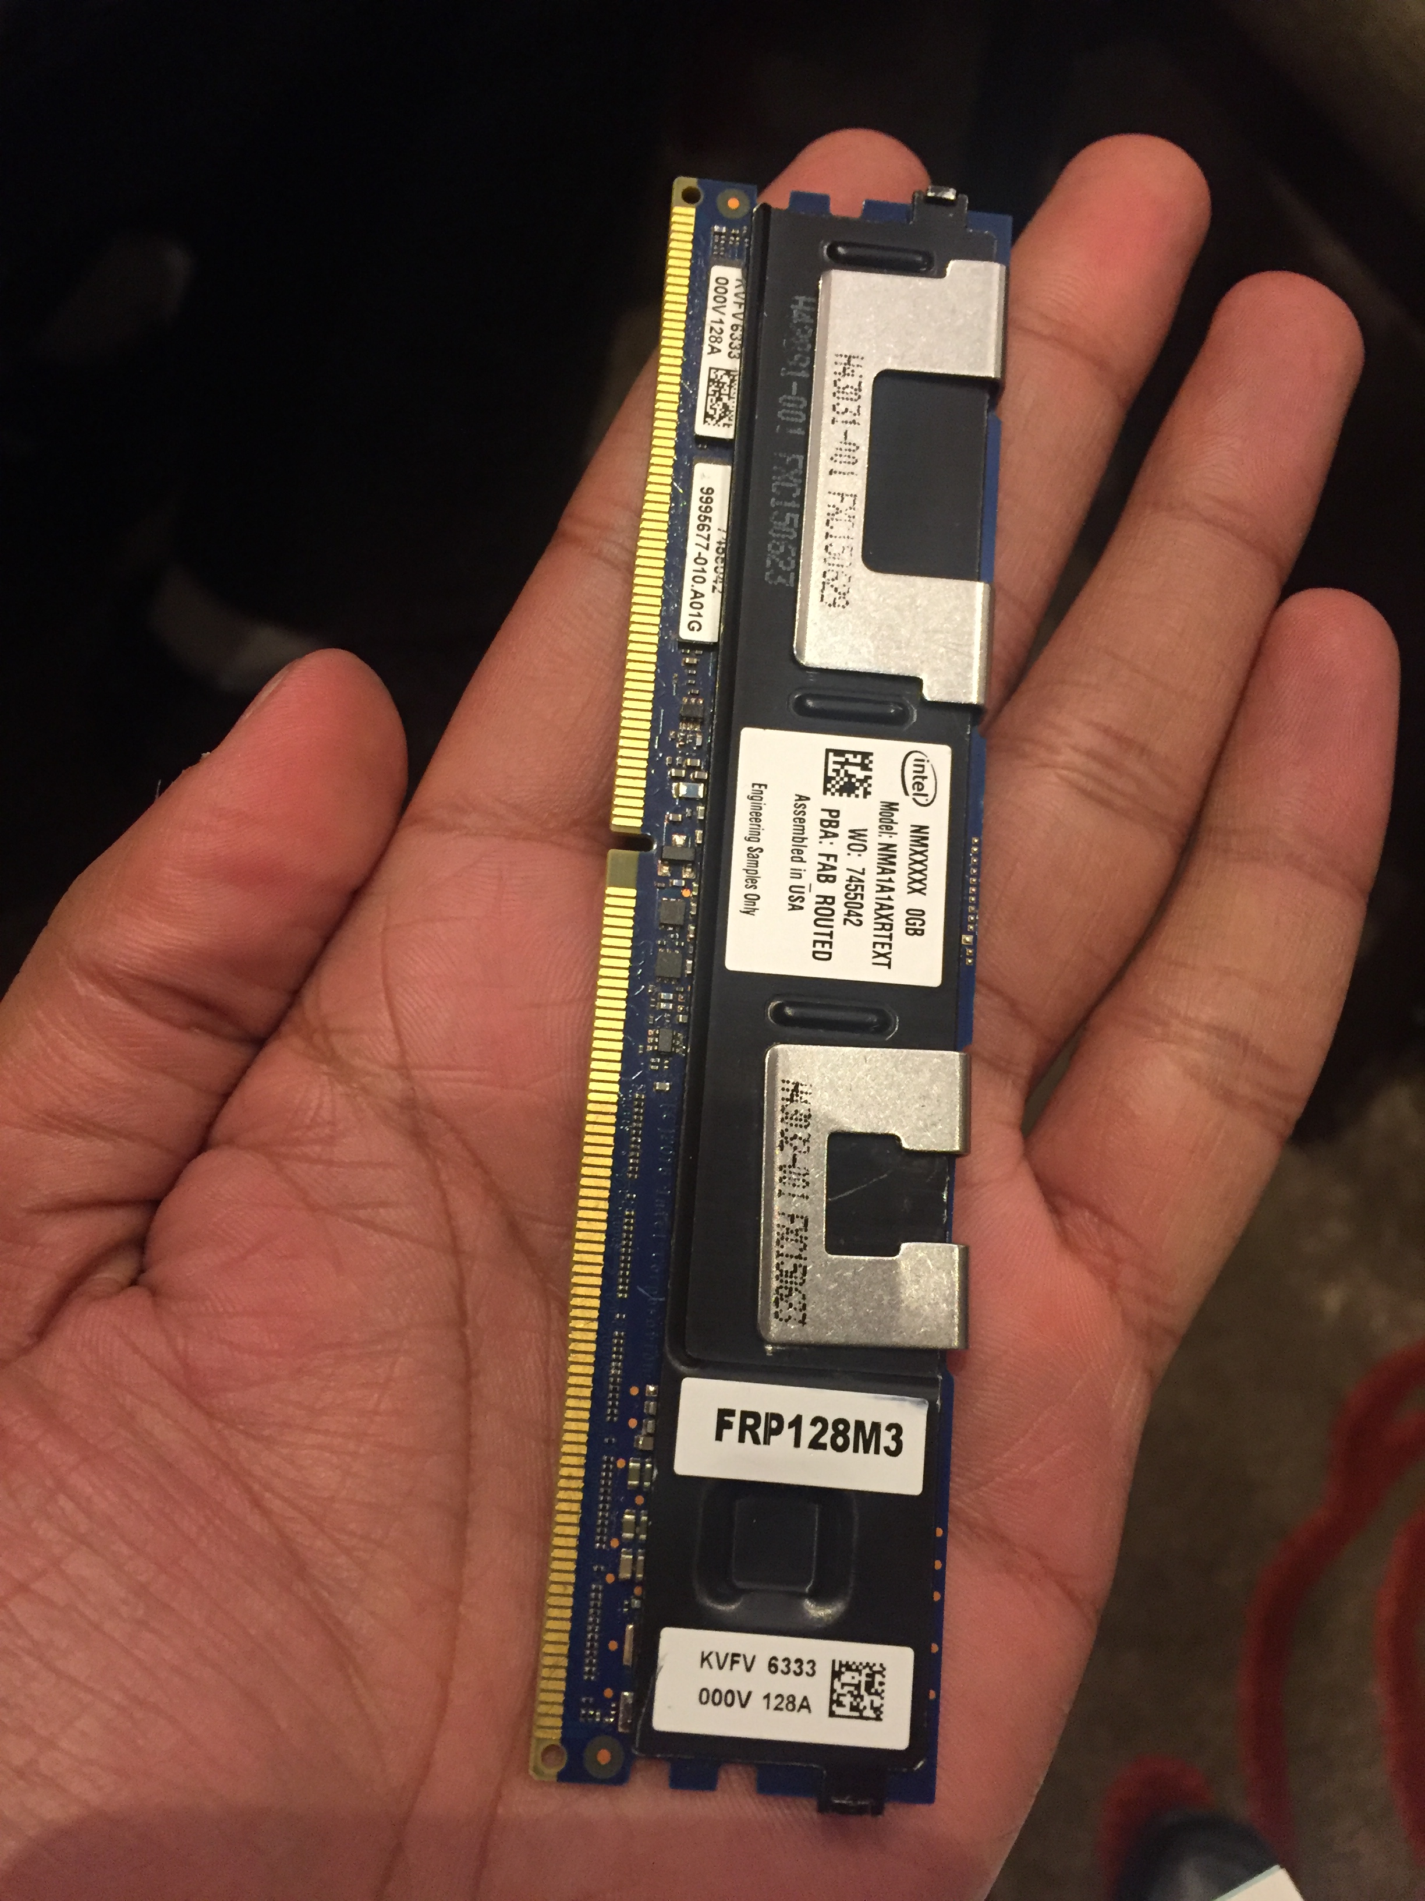
Persistent Memory (PM)
Intel and Micron’s PM offering
(Expected in 2019*)
Can revolutionize recovery data management

Slide 6
Future persistent memory systems
CPU
Store inst.
Store inst.
Recoverable data
Recovery
Volatile
Memory
Persistent
Memory
Promise: In-memory, recoverable data

Slide 7
Recovery needs ordered PM updates
Task: Fill node and add to linked list, safely
In-memory data
fillNewNode()
Recoverable
updateTailPtr()

Slide 8
Recovery needs ordered PM updates
Task: Fill node and add to linked list, safely
In-memory data
fillNewNode()
Recoverable
updateTailPtr()
No ordering → No recovery

Slide 9
Hidden sources of reordering
fillNewNode()
St A = x
St A ≤ St B, for recovery
updateTailPtr()
St B = y
Sources of reordering
Compiler
Cores
Caches
Memory Controller
St A = x
Core
St B = y
Caches
A
B
Recovery violated!
Need primitives to express order of PM writes

Slide 10
Memory persistency models
[Condit ‘09] [Pelley ‘14] [Intel ‘14] [Kolli ‘15] [Joshi ‘15] [ARM ‘16]
Programmers can express write order to PM
Hardware enforces write order
Example: x86’s clflush/clflushopt/clwb insts
Only helps persist data to local memory
Need remote memory persistency models
Fault tolerance, memory disaggregation, etc.

Slide 11
Challenges - I
Local system
Remote system
Core-1
Core-2
Core-1
Core-2
L1 $
L1 $
Network
L1 $
L1 $
Local
NIC
Remote
NIC
LLC
LLC
PM
PM
New hidden sources of buffering/reordering

Slide 12
Challenges - II
Manage increased memory latencies
<50ns vs ~2us
Use network bandwidth efficiently
Load/Store interface not optimal over the network
Extend local memory persistency models
Need HW-SW co-design to address challenges

Slide 13
Thank you!

Slide 14
Remote Memory Persistency
Aasheesh Kolli
Jayneel Gandhi
Irina Calciu
Stanko Novakovic
Dali, Salvador. The Persistence of Memory. 1931.
Museum of Modern Art. New York City.

