Slide 1



Towards Constraint-based Explanations for Answers and Non-Answers
Boris Glavic
Illinois Institute of Technology
Sven Köhler
University of California Davis
Sean Riddle
Athenahealth Corporation
Bertram Ludäscher
University of Illinois Urbana-Champaign

Slide 2
Outline
Introduction
Approach
Explanations
Generalized Explanations
Computing Explanations with Datalog
Conclusions and Future Work

Slide 3
Overview
Introduce a unified framework for generalizing explanations for answers and non-answers
Why/why-not question Q(t)
  Why is tuple t not in result of query Q?
Explanation
  Provenance for the answer/non-answer
Generalization
  Use an ontology to summarize and generalize explanations
Computing generalized explanations for UCQs
  Use Datalog
Notes:
The PROV standards is a standardized, extensible representation of provenance graphs which is very useful for exchange provenance information between systems.
Provenance-aware database manage system computes the provenance of database operations.
Such as perm, GProM, DBNotes, Orchestra and LogicBlox.

Slide 4
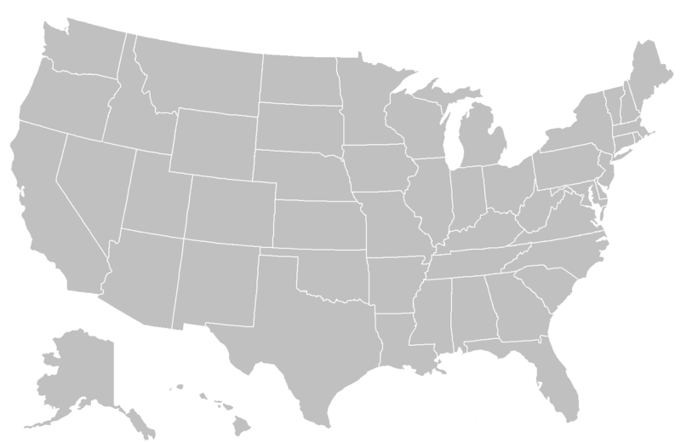
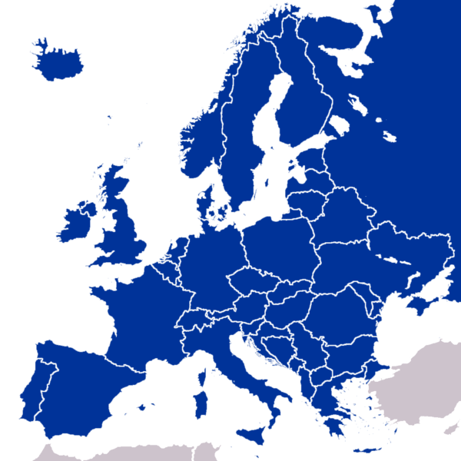
Train-Example
2hop(X,Y) :- Train(X,Z), Train(Z,Y).
Why can’t I reach Berlin from Chicago?
  Why-not 2hop(Chicago,Berlin)
From | To
New York | Washington DC
Washington DC | New York
New York | Chicago
Chicago | New York
… | …
Berlin | Munich
Munich | Berlin
… | …
Seattle
Chicago
New York
Berlin
Washington DC
Paris
Munich
Atlantic Ocean!
Notes:
The PROV standards is a standardized, extensible representation of provenance graphs which is very useful for exchange provenance information between systems.
Provenance-aware database manage system computes the provenance of database operations.
Such as perm, GProM, DBNotes, Orchestra and LogicBlox.

Slide 5
Train-Example Explanations
2hop(X,Y) :- Train(X,Z), Train(Z,Y).
Missing train connections explain why Chicago and Berlin are not connected
  E.g., if there only would exist a train line between New York and Berlin: Train(New York, Berlin)!
Seattle
Chicago
New York
Berlin
Washington DC
Paris
Munich
Atlantic Ocean!
Notes:
The PROV standards is a standardized, extensible representation of provenance graphs which is very useful for exchange provenance information between systems.
Provenance-aware database manage system computes the provenance of database operations.
Such as perm, GProM, DBNotes, Orchestra and LogicBlox.

Slide 6
Why-not Approaches
Two categories of data-based explanations for missing answers
1) Enumerate all failed rule derivations and why they failed (missing tuples)
  Provenance games
2) One set of missing tuples that fulfills optimality criterion
  e.g., minimal side-effect on query result
  e.g., Artemis, …
Notes:
The PROV standards is a standardized, extensible representation of provenance graphs which is very useful for exchange provenance information between systems.
Provenance-aware database manage system computes the provenance of database operations.
Such as perm, GProM, DBNotes, Orchestra and LogicBlox.

Slide 7
Why-not Approaches
1) Enumerate all failed rule derivations and why they failed (missing tuples)
  Exhaustive explanation
  Potentially very large explanations
    Train(Chicago,Munich), Train(Munich,Berlin)
    Train(Chicago,Seattle), Train(Seattle,Berlin)
    …
2) One set of missing tuples that fulfills optimality criterion
  Concise explanation that is optimal in a sense
  Optimality criterion not always good fit/effective
    Consider reach (transitive closure)
    Adding any train connection between USA and Europe - same effect on query result
Notes:
The PROV standards is a standardized, extensible representation of provenance graphs which is very useful for exchange provenance information between systems.
Provenance-aware database manage system computes the provenance of database operations.
Such as perm, GProM, DBNotes, Orchestra and LogicBlox.

Slide 8
Uniform Treatment of Why/Why-not
Provenance and missing answer approaches have been treated mostly independently
Observation:
  For provenance models that support query languages with “full” negation
    Why and why-not are both provenance computations!
  Q(X) :- Train(chicago,X).
  Why-not Q(New York)?
    Equivalent to why Q’(New York)?
    Q’(X) :- adom(X), not Q(X)
Notes:
The PROV standards is a standardized, extensible representation of provenance graphs which is very useful for exchange provenance information between systems.
Provenance-aware database manage system computes the provenance of database operations.
Such as perm, GProM, DBNotes, Orchestra and LogicBlox.

Slide 9
Outline
Introduction
Approach
Explanations
Generalized Explanations
Computing Explanations with Datalog
Conclusions and Future Work

Slide 10
Unary Train-Example
Q(X) :- Train(chicago,X).
Why-not Q(berlin)
  Explanation: Train(chicago,berlin)
Consider an available ontology!
  More general: Train(chicago,GermanCity)
Seattle
Chicago
New York
Berlin
Washington DC
Paris
Munich
Atlantic Ocean!
Notes:
The PROV standards is a standardized, extensible representation of provenance graphs which is very useful for exchange provenance information between systems.
Provenance-aware database manage system computes the provenance of database operations.
Such as perm, GProM, DBNotes, Orchestra and LogicBlox.

Slide 11
Unary Train-Example
Q(X) :- Train(chicago,X).
Why-not Q(berlin)
  Explanation: Train(chicago,berlin)
Consider an available ontology!
  Generalized explanation:
    Train(chicago,GermanCity)
  Most general explanation:
    Train(chicago,EuropeanCity)
Notes:
The PROV standards is a standardized, extensible representation of provenance graphs which is very useful for exchange provenance information between systems.
Provenance-aware database manage system computes the provenance of database operations.
Such as perm, GProM, DBNotes, Orchestra and LogicBlox.

Slide 12
Our Approach
Explanations for why/why-not questions
  over UCQ queries
  Successful/failed rule derivations
Utilize available ontology
  Expressed as inclusion dependencies
    “mapped” to instance
  E.g., city(name,country)
    GermanCity(X) :- city(X,germany).
Generalized explanations
  Use concepts to describe subsets of an explanation
Most general explanation
  Pareto-optimal
Notes:
The PROV standards is a standardized, extensible representation of provenance graphs which is very useful for exchange provenance information between systems.
Provenance-aware database manage system computes the provenance of database operations.
Such as perm, GProM, DBNotes, Orchestra and LogicBlox.

Slide 13
Related Work - Generalization
ten Cate et al. High-Level Why-Not Explanations using Ontologies [PODS ‘15]
  Also uses ontologies for generalization
  We summarize provenance instead of query results!
  Only for why-not, but, extension to why trivial
Other summarization techniques using ontologies
  Data X-ray
  Datalog-S (datalog with subsumption)

Slide 14
Outline
Introduction
Approach
Explanations
Generalized Explanations
Computing Explanations with Datalog
Conclusions and Future Work

Slide 15
Rule derivations
What causes a tuple to be or not be in the result of a query Q?
  Tuple in result – exists >= 1 successful rule derivation which justifies its existence
    Existential check
  Tuple not in result - all rule derivations that would justify its existence have failed
    Universal check
Rule derivation
  Replace rule variables with constants from instance
  Successful: body if fulfilled

Slide 16
Basic Explanations
A basic explanation for question Q(t)
Why - successful derivations with Q(t) as head
Why-not - failed rule derivations
  Replace successful goals with placeholder T
  Different ways to fail
2hop(Chicago,Munich) :- Train(Chicago,New York), Train(New York,Munich).
2hop(Chicago,Munich) :- Train(Chicago,Berlin), Train(Berlin,Munich).
2hop(Chicago,Munich) :- Train(Chicago,Paris), Train(Paris,Munich).
Seattle
Chicago
New York
Berlin
Washington DC
Paris
Munich

Slide 17
Explanations Example
Why 2hop(Paris,Munich)?
2hop(Paris,Munich) :- Train(Paris,Berlin),
Train(Berlin,Munich).
Seattle
Chicago
New York
Berlin
Washington DC
Paris
Munich

Slide 18
Outline
Introduction
Approach
Explanations
Generalized Explanations
Computing Explanations with Datalog
Conclusions and Future Work

Slide 19
Generalized Explanation
Generalized Explanations
  Rule derivations with concepts
Generalizes user question
  generalize a head variable
2hop(Chicago,Berlin) – 2hop(USCity,EuropeanCity)
Summarizes provenance of (non-) answer
  generalize any rule variable
2hop(New York,Seattle) :- Train(New York,Chicago),
Train(Chicago,Seattle).
2hop(New York,Seattle) :- Train(New York,USCity),
Train(USCity,Seattle).

Slide 20
Generalized Explanation Def.
For user question Q(t) and rule r
  r(C₁,…,C_{n})
  (C₁,…,C_{n}) subsumes user question
  headvars(C₁,…,C_{n}) only cover existing/ missing tuples
  For every tuple t’ covered by headvars(C₁,…,C_{n}) all rule derivations for t’ covered are explanations for t’

Slide 21
Recap Generalization Example
r: Q(X) :- Train(chicago,X).
Why-not Q(berlin)
  Explanation: r(berlin)
Generalized explanation:
  r(GermanCity)

Slide 22
Most General Explanation
  Domination Relationship
    r(C₁,…,C_{n}) dominates r(D₁,…,D_{n})
    if for all i: C_{i} subsumes D_{i}
    and exists i: C_{i} strictly subsumes D_{i}
Most General Explanation
  Not dominated by any other explanation
Example most general explanation:
  r(EuropeanCity)

Slide 23
Outline
Introduction
Approach
Explanations
Generalized Explanations
Computing Explanations with Datalog
Conclusions and Future Work

Slide 24
Datalog Implementation
Rules for checking subsumption and domination of concept tuples
Rules for successful and failed rule derivations
  Return variable bindings
Rules that model explanations, generalization, and most general explanations

Slide 25
Modeling Subsumption
Basic concepts and concepts
  isBasicConcept(X) :- Train(X,Y).
  isConcept(X) :- isBasicConcept(X).
  isConcept(EuropeanCity).
Subsumption (inclusion dependencies)
  subsumes(GermanCity,EuropeanCity).
  subsumes(X,GermanCity) :- city(X,germany).
Transitive closure
  subsumes(X,Y) :- subsumes(X,Z), subsumes(Z,Y).
Non-strict version
  subsumesEqual(X,X) :- isConcept(X).
  subsumesEqual(X,Y) :- subsumes(X,Y).

Slide 26
Capture Rule Derivations
Rule r₁:2hop(X,Y) :- Train(X,Z), Train(Z,Y).
Success and failure rules
r₁_success(X,Y,Z) :- Train(X,Z),
Train(Z,Y).
r₁_fail(X,Y,Z) :- isBasicConcept(X),
isBasicConcept(Y),
isBasicConcept(Z),
not r₁_success(X,Y,Z).
More general:
r₁(X,Y,Z,true,false) :- isBasicConcept(Y),
Train(X,Z), not Train(Z,Y).

Slide 27
Model Generalization
Explanation for Q(X) :- Train(chicago,X).
expl_r₁_success(C₁,B₁) :−
subsumesEqual(B₁,C₁),
r₁_success(B₁),
not has_r₁_fail(C₁).
User question: Q(B₁)
Explanation: Q(C₁) :- Train(chicago, C₁).
Q(B₁) exists and justified by r₁: r₁_success(B₁)
r₁ succeeds for all B in C₁: not has_r₁_fail(C₁)

Slide 28
Model Generalization
Explanation for Q(X) :- Train(chicago,X).
expl_r₁_success(C₁,B₁) :−
subsumesEqual(B₁,C₁),
r₁_success(B₁),
not has_r₁_fail(C₁).

Slide 29
Model Generalization
Domination
dominated_r₁_success(C₁,B₁) :-
expl_r₁_success(C₁,B₁),
expl_r₁_success(D₁,B₁),
subsumes(C₁, D₁).
Most general explanation
most_gen_r₁_success(C₁,B₁) :-
expl_r₁_success(C₁,B₁),
not dominated_r₁_success(C₁,B₁).
Why question
why(C₁) :- most_gen_r₁_success(C₁,seattle).

Slide 30
Outline
Introduction
Approach
Explanations
Generalized Explanations
Computing Explanations with Datalog
Conclusions and Future Work

Slide 31
Conclusions
Unified framework for generalizing provenance-based explanations for why and why-not questions
Uses ontology expressed as inclusion dependencies (Datalog rules) for summarizing explanations
Uses Datalog to find most general explanations (pareto optimal)

Slide 32
Future Work I
Extend ideas to other types of constraints
E.g., denial constraints
  German cities have less than 10M inhabitants
  :- city(X,germany,Z), Z > 10,000,000
Query returns countries with very large cities
  Q(Y) :- city(X,Y,Z), Z > 15,000,000
Why-not Q(germany)?
  Constraint describes set of (missing) data
  Can be answered without looking at data
    Semantic query optimization?

Slide 33
Future Work II
Alternative definitions of explanation or generalization
  Our gen. explanations are sound,
  but not complete
  Complete version
  Concept covers at least explanation
  Sound and complete version:
  Concepts cover explanation exactly
Queries as ontology concepts
  As introduced in ten Cate

Slide 34
Future Work III
Extension for FO queries
  Generalization of provenance game graphs
  Need to generalize interactions of rules
Implementation
  Integrate with our provenance game
  engine
    Powered by GProM!
    Negation - not yet
    Generalization rules - not yet

Slide 35
Questions?
Boris
  http://cs.iit.edu/~dbgroup/index.html
Bertram
  https://www.lis.illinois.edu/people/faculty/ludaesch

Slide 36
Relationship to (Constraint) Provenance Games

